Slide 1


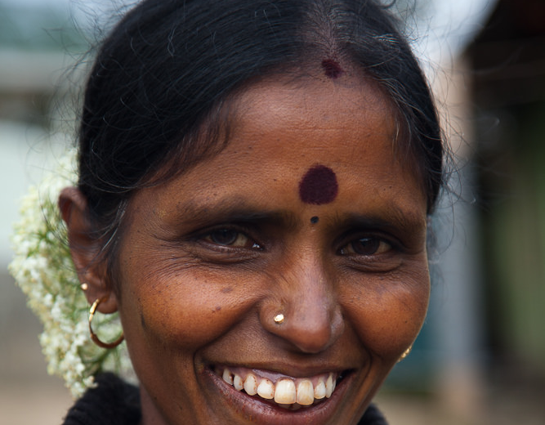
The Bindi and (Women’s) Faces

Slide 2
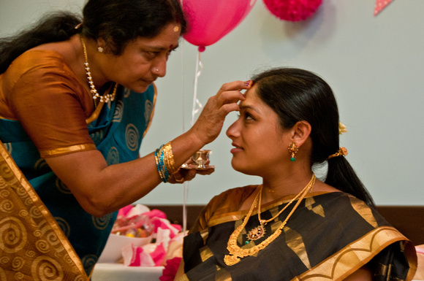
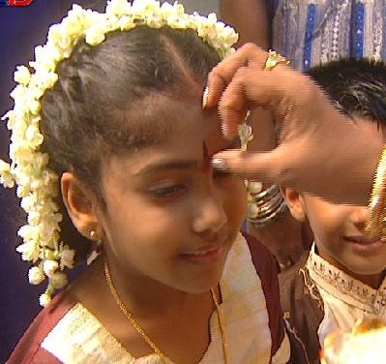
A SIGN OF RESPECT OF OTHER WOMEN
A COMMUNITY WELCOME
CAN VARY IN SHAPE, COLOR, STYLE, COMPOSITION
CONTEXT-DEPENDENT (OCCASION, INFORMATION ABOUT THE PERSON, PLACE)

Slide 3

Information conveyed on the most powerful social communication tools – the face
RELIGIOUS CUES
CUES OF VALUES AND FAMILY BACKGROUND
REGIONAL CUES
CAN BE A SPACE FOR INFORMATION TO BE PROJECTED BY AN INDIVIDUAL
CAN BE A SPACE FOR INFORMATION PROJECTED BY THEIR COMMUNITY

Slide 4
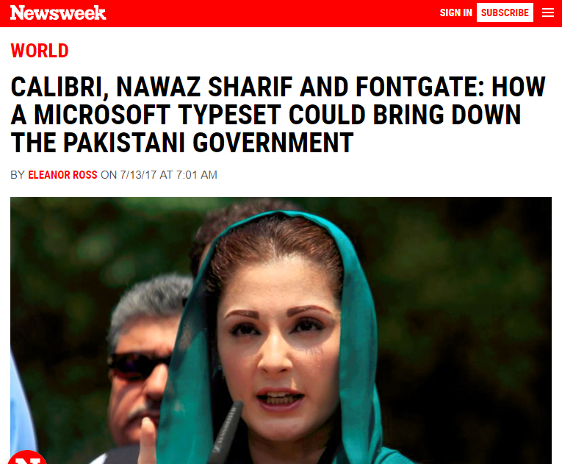
Calibri and Content

Slide 5
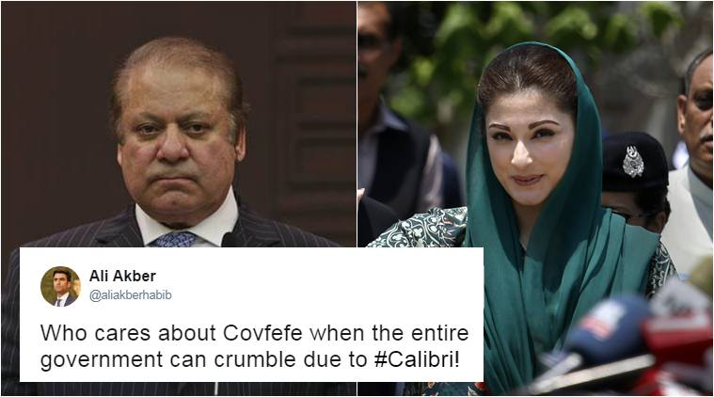
An unintentional information leak due to a sans-serif font
TYPOGRAPHY ADDED LIFE-CHANGING INFORMATION
(REVEALING STRONG EVIDENCE OF A DOCUMENT BEING BACK-DATED)
FULL STORY: https://www.newsweek.com/brief-history-calibri-font-could-bring-down-pakistani-government-635794

Slide 6
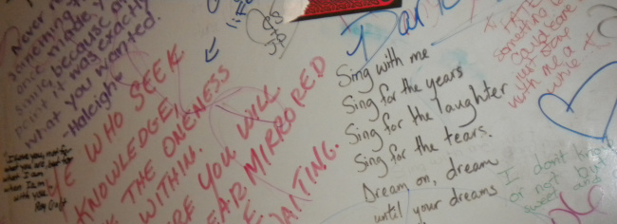
Writing on the bathroom wall

Slide 7
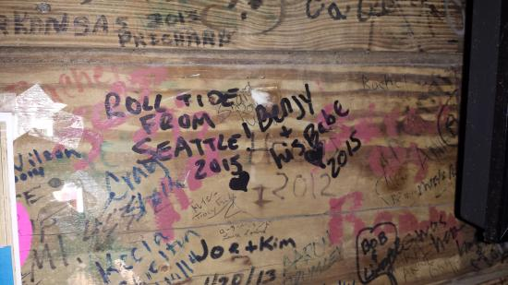

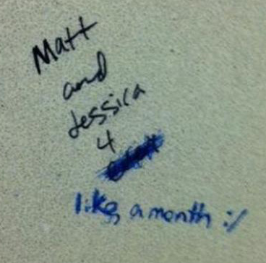
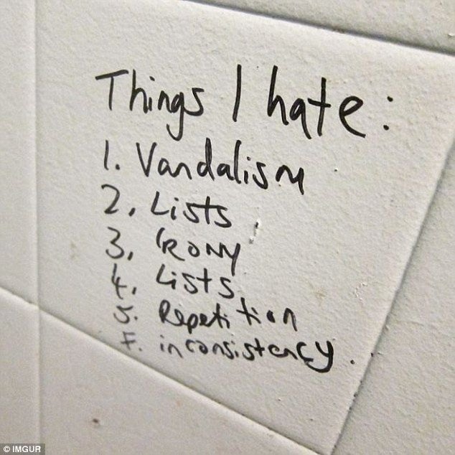
Creative spaces
GRAFFITI THAT IS DONE WITHOUT MUCH PLANNING, NOT MUCH TO LOSE
A WAY TO LEAVE A MARK ON A PUBLIC SPACE (LIKE A HIGH SCHOOL) BUT ONLY IF YOU LOOK HARD ENOUGH, AN INTERESTING WAY PEOPLE INTERACT WITH THEIR ENVIRONMENT/TEST THEIR VOICES
CAN PROVIDE INFORMATION ABOUT TIME (CHRONOLOGY OF DIFFERENT MESSAGES, REFERENCES)
POTENTIALLY HAS A SUBCONSCIOUS EFFECT ON A WIDE AUDIENCE, E.G. CAN SET A SCHOOL CULTURE

